Slide 1
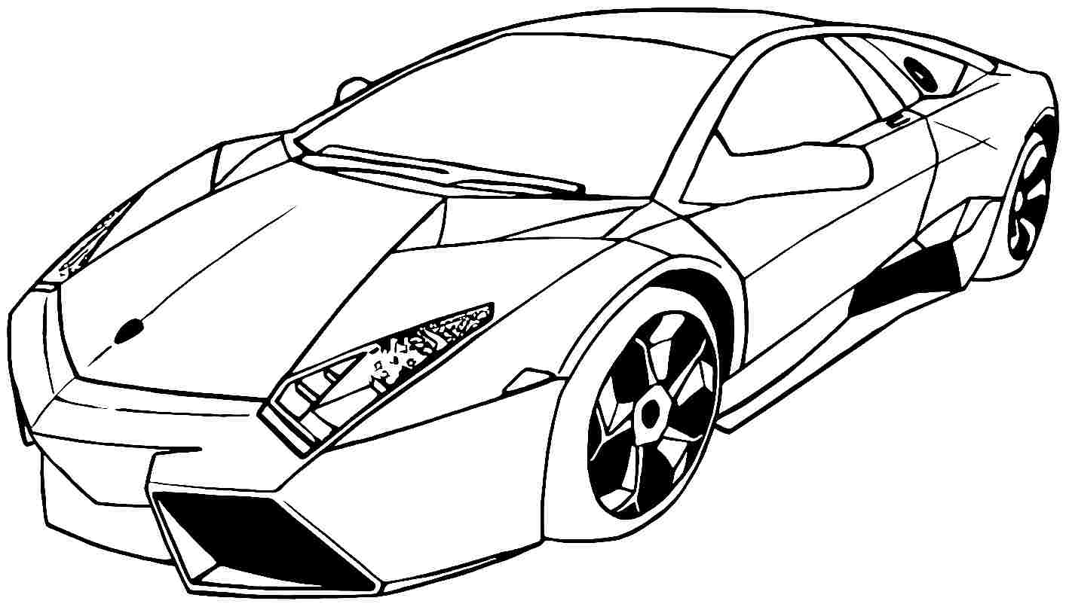

Slide 2
JAIN CAR RENTALS
DRIVE IN STYLE

Slide 3
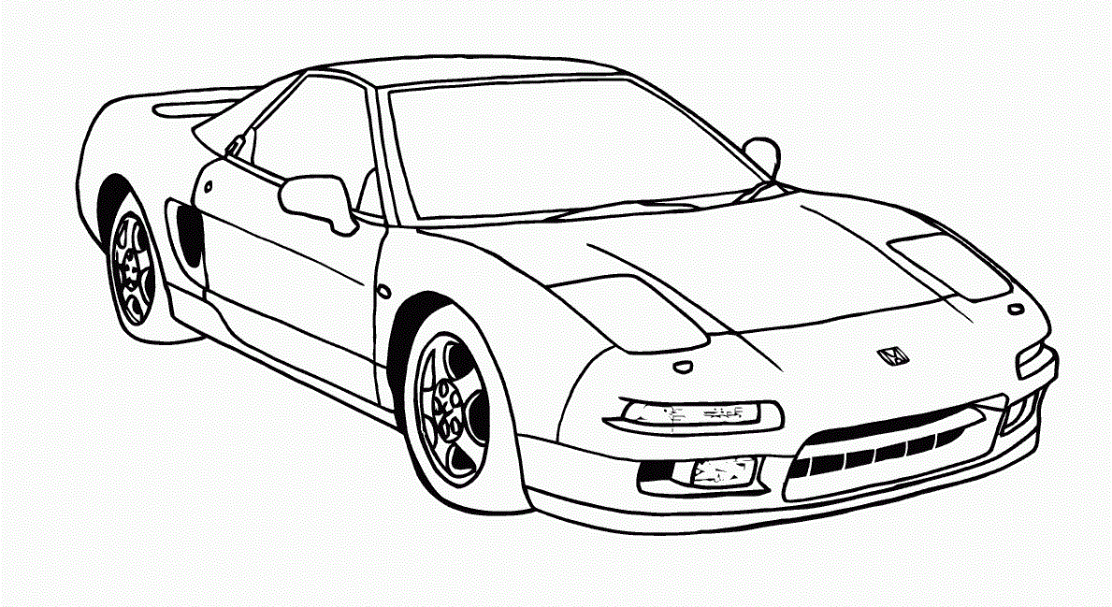
JAIN CAR RENTALS
DRIVE IN STYLE

Slide 4
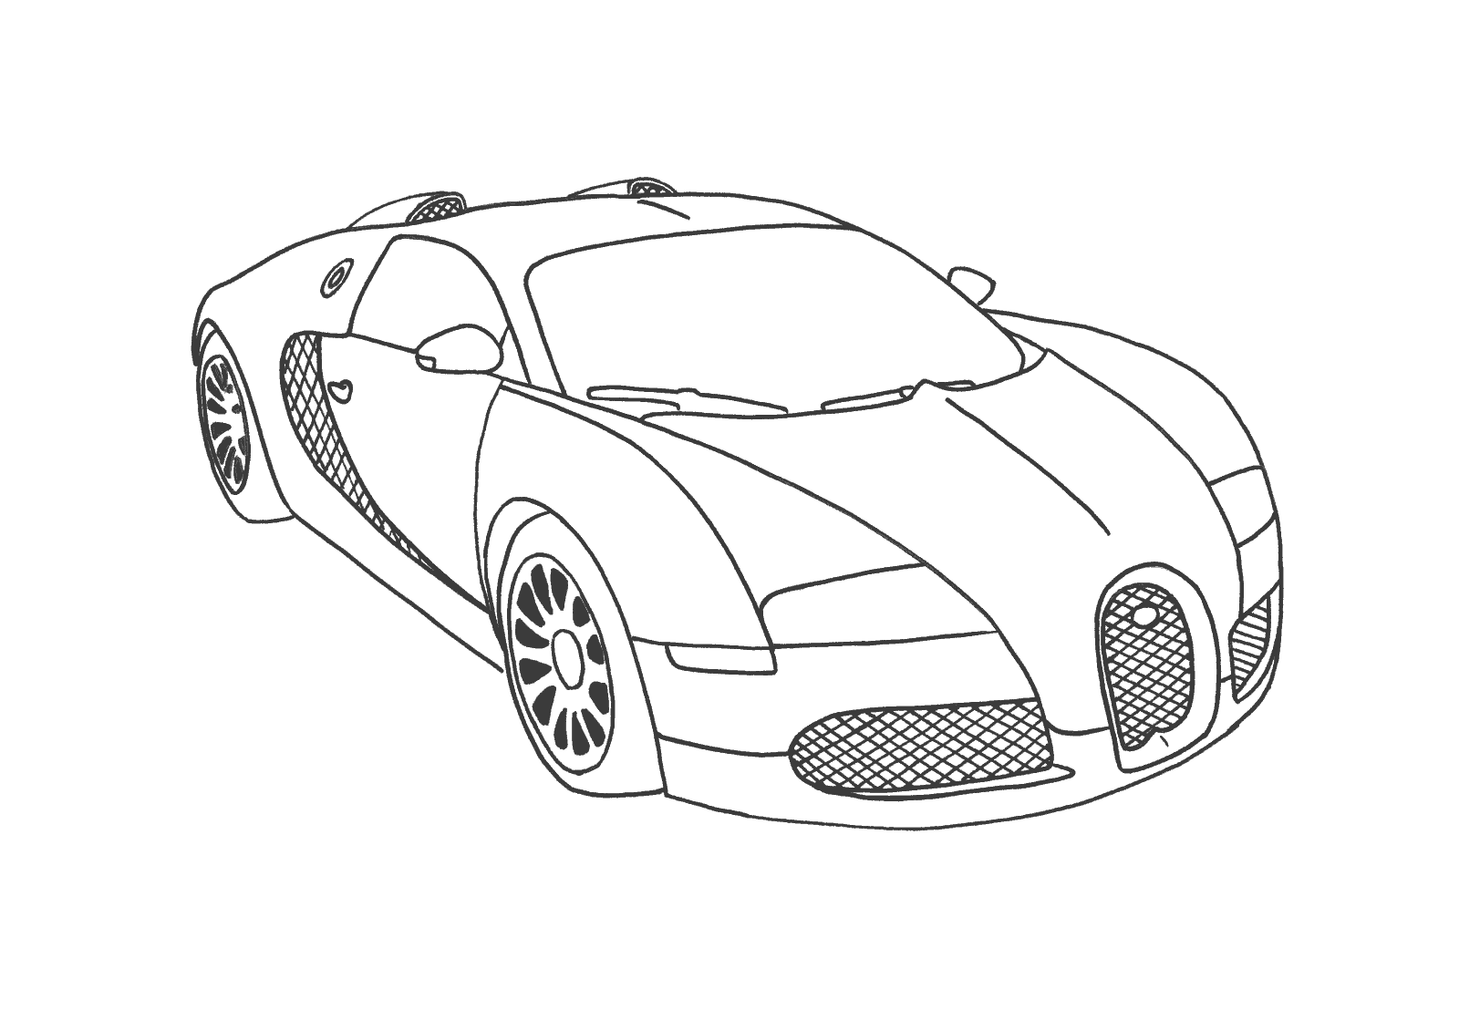
JAIN CAR RENTALS
DRIVE IN STYLE

Slide 5
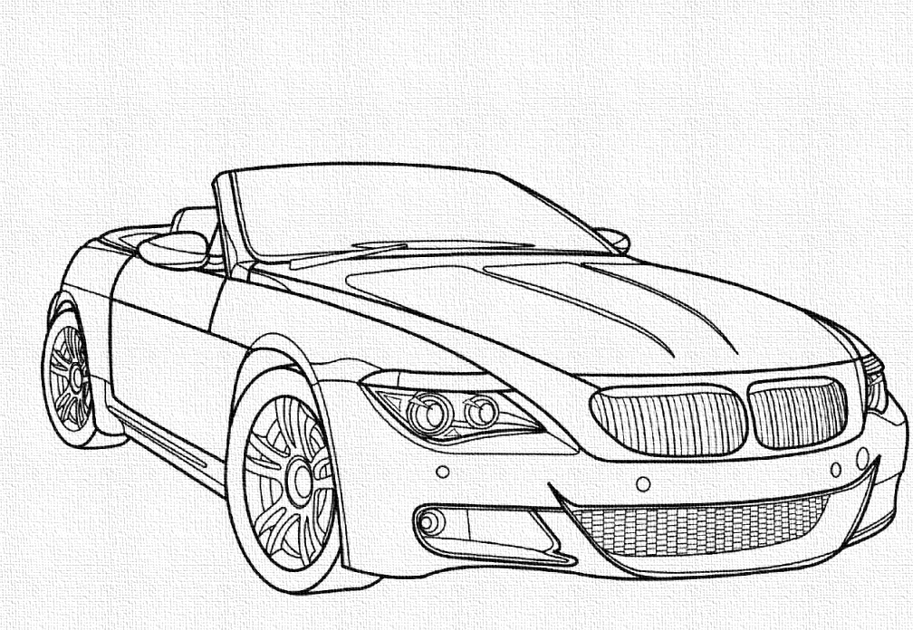

Slide 6
JAIN CAR RENTALS
DRIVE IN STYLE

Slide 7
JAIN CAR RENTALS
DRIVE IN STYLE

Slide 8
JAIN CAR RENTALS
DRIVE IN STYLE

Slide 10

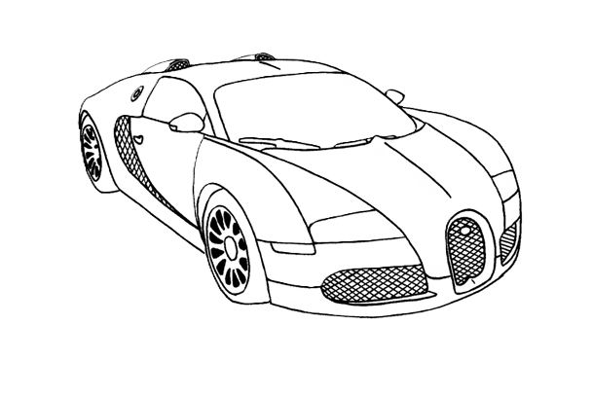
The second one is transparent
Don’t delete

Slide 11
